Slide 1
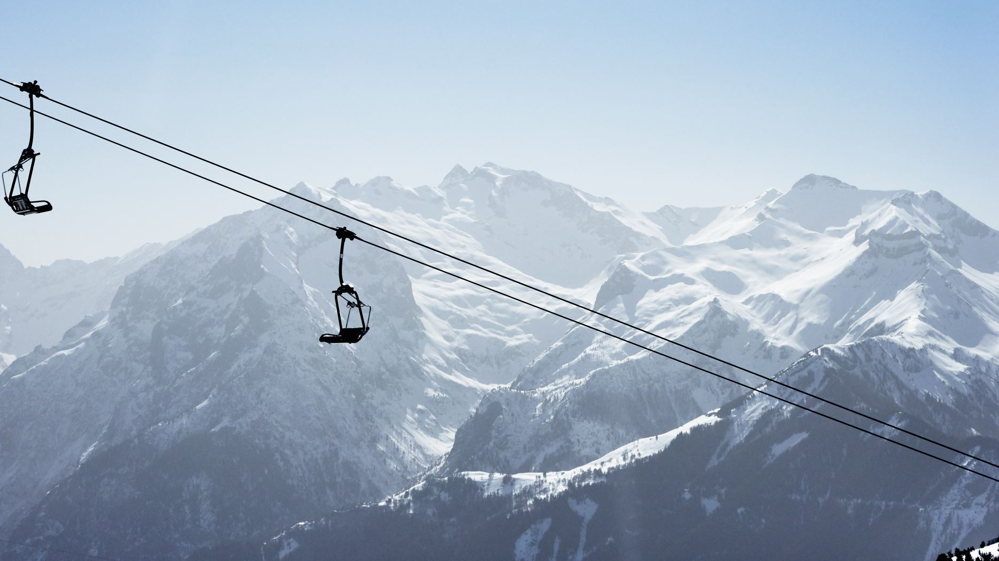

Big Mountain Resort
Ticket Pricing Strategy
Presented by: Ranjana Roka

Slide 2
Overview
Problem Identification
Key Findings and Recommendation
Modeling Results and Analysis
Summary and Conclusion

Slide 3

Problem Identification
Current Situation
Additional chair lift increases operating costs by $1.54M
Premium pricing strategy based on market average.
Current Ticket Price: $81.00
The resort is not fully capitalizing on its facilities

Slide 4
Key Findings
Target Feature: AdultWeekend Ticket Price
Resort-Specific Features:
Vertical_drop
fastQuads
Runs
Total_chairs
Resort-specific features showed stronger correlation with the target feature.

Slide 5
Modeling Result and Analysis
Current Ticket Price: $81.00 for an adult weekend ticket
Modelled Price: $89.05, suggesting that Big Mountain is underpricing its tickets by approximately $8.05.
MAE = $6.69 suggests there is room for a price increase
Increasing Vertical Drop and Adding Snow Making Coverage: Slight ticket price increase ($0.24-$0.25) with a revenue boost of $424,242-$441,919 over the season.

Slide 6
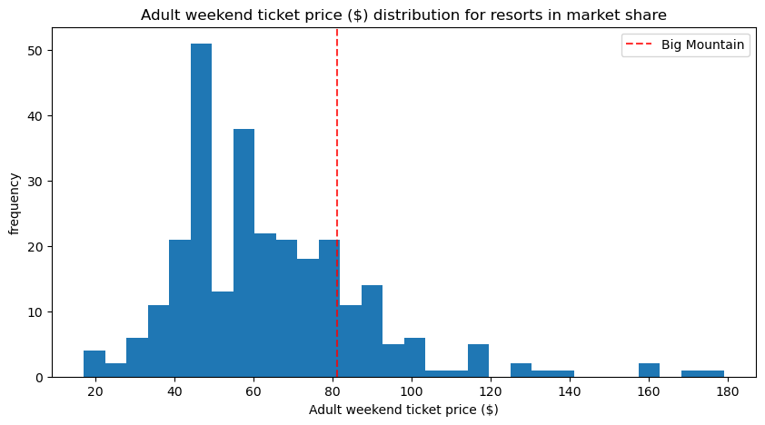
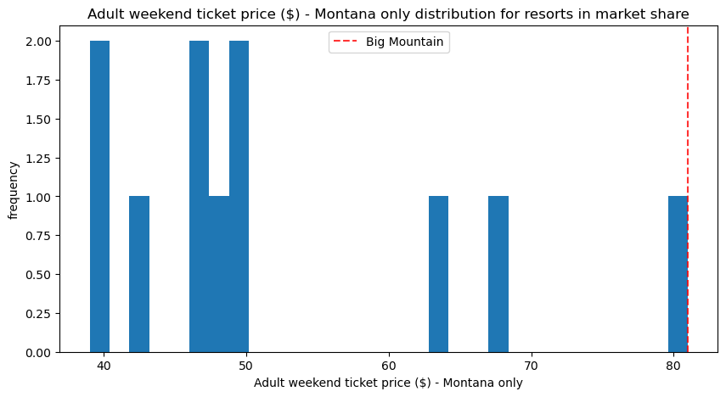
Target Feature: AdultWeekend Ticket Price

Slide 7
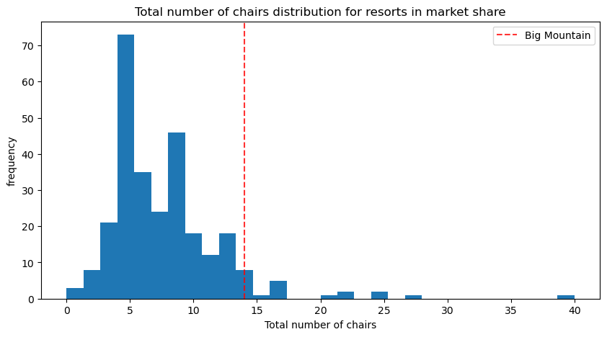
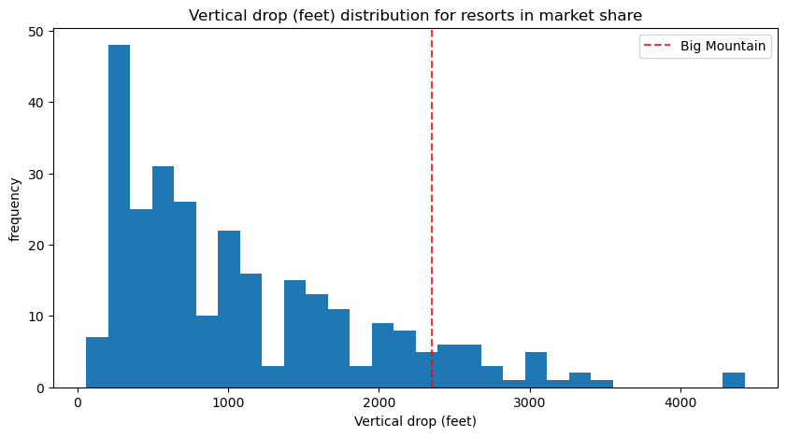
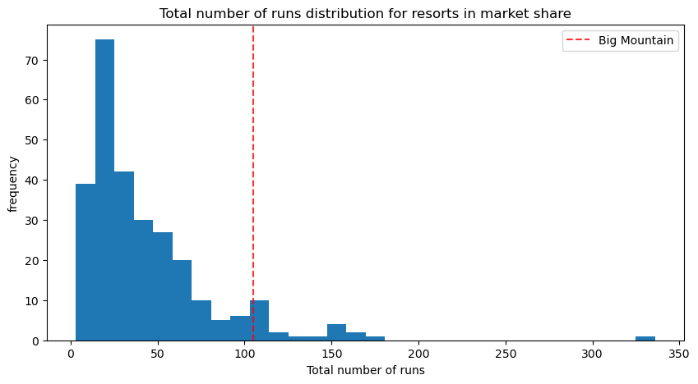
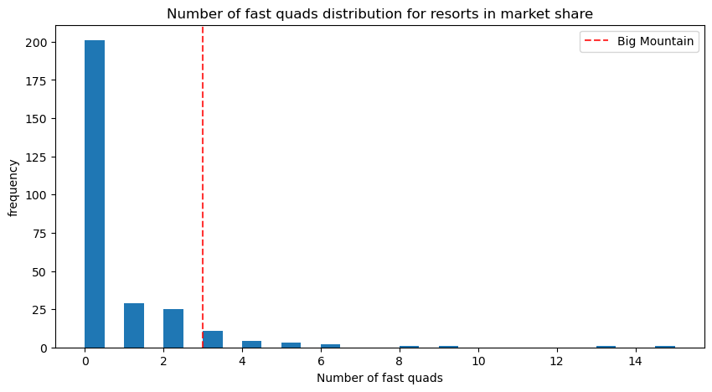
Resort-specific Feature Comparisons

Slide 8
Recommendations:
Raise ticket price to $89.05 as predicted by the model
Closing less used runs can be a cost-saving measure without affecting the ticket price.
Enhancements such as increasing vertical drop by 150 feet, and add an additional chairlift supported ticket price by $0.24, translating to a revenue increase of $424,242 over the season.
Focus on improving overall visitor experience to support price adjustments.

Slide 9
Conclusion
Big Mountain's ticket price is lower than many ski resorts, suggesting room to align pricing with higher-priced competitors.
Incremental improvements such as increasing vertical drop and snow making coverage show marginal benefits, emphasizing the need for a balanced approach between facility investments and pricing strategies

Slide 10

Thank you
Questions????

